Slide 1

WEATHER FORECASTING WEB APPLICATION
A PROJECT REPORT
Submitted by
RAJAT SINGH (21BCS4801) TILAK RAJ (21BCS4773) ADITAY (21BCS4736)
in partial fulfillment for the award of the degree of
BACHELORS OF ENGINEERING
IN
COMPUTER SCIENCE
Chandigarh University
AUGUST 2023

Slide 2

BONAFIDE CERTIFICATE
Certified that this project report “PREDICTING AIR POLLUTION LEVEL FOR SPECIFIC CITY ” is the Bonafede work of “ RAJAT SINGH, TILAK RAJ AND ADITYA” who carried out the project work under my/our supervision.
SIGNATURE
SIGNATURE
AD. Sandeep Singh Kang
Er. Ashish (E16078)
HEAD OF THE DEPARTMENT
SUPERVISOR
Assistant Professor
CSE
CSE
Submitted for the project viva-voce examination held on
INTERNAL EXAMINER
EXTERNAL EXAMINER

Slide 3
TABLE OF CONTENTS
List of Figures ......................................................................................................................... 4
CHAPTER 1. INTRODUCTION .........................................................................08
1.1. Identification of Client/ Need/ Relevant Contemporary issue .........................................08 1.2. Identification of Problem .................................................................................................08 1.3. Identification of Tasks......................................................................................................09 1.4. Timeline ............................................................................................................................10 1.5. Organization of the Report .................................................................................................10
CHAPTER 2. DESIGN FLOW/PROCESS…………………………...…….......12
2.1. Evaluation & Selection of Features………………………………………………………....12 2..2. Design Constraints……………………………………………………………………….......13
2.3. Analysis of Features and finalization subject to constraints………………………………...15 2..4. Design Flow…….…………………………………………………………………………...16 2.5. Design Selection…………………………………………………………………………......19
2.6. Implementation plan/methodology………………………………………………………….20
CHAPTER 3. RESULT ANALYSIS AND VALIDATION ……..........................22
3.1. Implementation of Solution………………………………………………………………...................22
CHAPTER 4. CONCLUSION AND FUTURE WORK…………….…….........25
4.1. Conclusion………………………..………………………………………………………...................25
4.2. Future Work……..……………………………………………………………………….....................25
REFERENCES…………………………………………………………………...27
USER MANUAL………………………………………………………………....28

Slide 4
LIST OF FIGURES
Figure 1.1 Time line of the project (Gantt Chart)……………………………………….10
Figure 2.1 ER Diagram………………………………………………………………...17
Figure 2.2 Use Case Diagram………………………………………………………….18
Figure 2.3 Specific ER Diagram ………………………………………………………19
Figure 2.4 Flowchart …………………………………………………………………..21
Figure 3.1 web application home page……………………………………………23 Figure 3.2 web application precipitation chart……………………………………...24 Figure 3.3 web application heat map……………………...…………………………….24

Slide 5
ABSTRACT
The project aims to predict the Air Quality Index (AQI) for a particular city employing a Support Vector Machine (SVM) Model. The SVM is prepared on historical AQI information at the side other significant highlights such as temperature, stickiness, wind speed, and precipitation. The dataset utilized for preparing and testing the demonstrate is gotten from dependable sources such as government organizations and climate administrations. The extend includes information pre- processing, highlight choice, show preparing, hyperparameter tuning, and show assessment. The execution of the SVM model is assessed utilizing measurements such as mean absolute error (MAE), root mean square error (RMSE), and R-squared score. The comes about of the project illustrate the potential of the SVM model in precisely foreseeing the AQI for a particular city, which can be valuable for air quality management and open wellbeing purposes. The results indicate that the SVM model can effectively predict the AQI of the target city with high accuracy. The model provides and efficient and reliable tool for policymakers and environmental agencies to assess the air quality of a city and take necessary actions to improve it. This study demonstrates the potential of machine learning algorithms in forecasting AQI and can be extended to other cities for environmental monitoring and management.

Slide 6
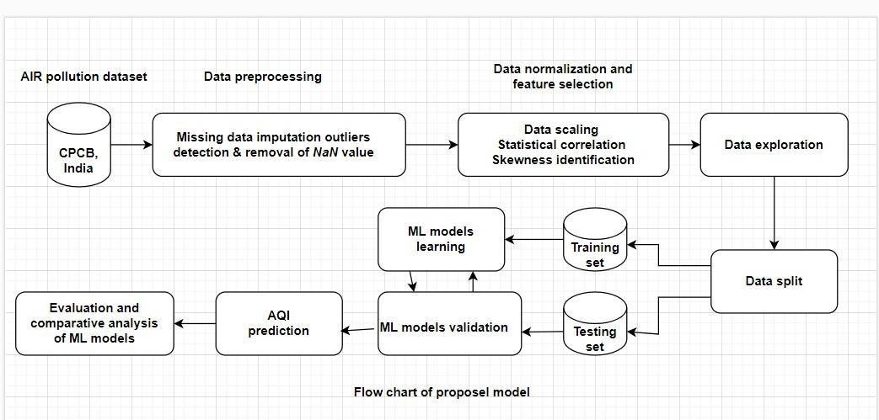
GRAPHICALABSTRACT
A possible graphical abstract might appear a flowchart of the method for anticipating air quality using SVM. The flowchart might begin with data collection and pre-processing, taken after by the determination and tuning of the SVM model. The demonstrate seem at the point be assessed on a test set, and the comes about may be well translated and communicated to partners through visualization and reports. The graphical theoretical might moreover incorporate pictures of the target city, meteorological parameter, and the AQI. Generally, the graphical abstract may pass on the significance of utilizing machine learning calculations for natural checking and administration and the potential of SVM for anticipating AQI.

Slide 7
ABBREVIATIONS
ML: Machine Learning
PM: Particulate Matter
AQI: Air Quality Index
KE: Kernel Effect
MAE: Mean Absolute Error RMSE: Root Mean Square Error SVR: Support Vector Machine

Slide 8
INTRODUCTION
1.1. Identification of Client /Need / Relevant Contemporary issue
The oxygen we breathe is the introductory element of life, because it's veritably important for the functioning of the cells in the mortal body. Air is one of the most important rudiments on Earth. We humans can live days without water, while we can not live a many twinkles without air. Air also maintains the face temperature of earth by circulating warm and cool air. Water rotation also depends on air. The air we breathe not only gives us life, but also determines our quality of life. Changes in health can largely be attributed to poor air quality. weakened air can be veritably dangerous in numerous ways, for illustration it can beget respiratory conditions similar as tuberculosis, pneumonia, bronchitis, asthma and lung cancer. It's that air pollution kills about 7 million people worldwide every time. Air pollution can also lead to global warming, which is the process of enmeshing heat in the air, causing consequences similar as rising temperatures, rising ocean situations, heat- related ails and contagious conditions that beget contagious conditions.
The purpose of the AQI is to advise people about the air where they live, tell them which groups of people the air may affect, and what steps people can take to avoid exposure to air pollution. AQI focuses on the health goods that people can witness after breathing weakened air within hours or days
We worked with supervised literacy algorithms because we've access to labelled data and also set up that supervised algorithms are more accurate than unsupervised algorithms. This design compares colorful supervised machine learning algorithms and selects the most accurate algorithm for AQI vaticination using the" Air quality indicator in India( 2015- 2020)" dataset. AQI is calculated using the PM2.5, PM 10 and NO2 attributes of the dataset.
The main thing of this exploration is to determine the most accurate supervised machine learning algorithm to produce a model that can prognosticate AQI. We're also trying to figure out how machine literacy can help control air pollution.
1.2. Identification of Problem
colorful models similar as statistical, deterministic, physical, and machine literacy( ML) models have been used in the literature to prognosticate AQI. Traditional ways grounded on chances and statistics are veritably complex and less effective. ML- grounded AQI vaticination models have been shown to be more dependable and harmonious. Advanced technologies and detectors have made data collection easy and accurate. Accurate and dependable prognostications grounded on similar huge environmental data bear in- depth analysis that only ML algorithms can handle effectively. We've examined six times of civic air pollution data in India and analysed ten times of

Slide 9
air pollution and AQI. The dataset ispre-processed and gutted, also data visualization ways are applied to gain better understanding and explore retired patterns and trends. This work uses the nature of the correlation measure with ML models, which has been used by only a many experimenters in the literature. Data imbalances are detected and corrected using the SVM fashion.
1.3. Identification of Tasks
Among the contaminant indicator, Fine particulate matter( PM2.5) is a significant bone because it's a big concern to people’s health when its position in the air is fairly high. This design tried to apply some machine literacy ways to prognosticate PM2.5 situations grounded on a dataset conforming of diurnal rainfall and business parameter.
Predicting air quality is a complex task due to the dynamic nature, volatility, and high variability in time and space of adulterants and particulates. At the same time, being suitable to model, prognosticate, and cover air quality is getting more and more applicable, especially in civic areas, due to the observed critical impact of air pollution on citizens’ health and the terrain. In this paper, we employ a popular machine literacy system, support vector retrogression(SVR), to read contaminant and particulate situations and to prognosticate the air quality indicator( AQI). Among the colorful tested druthers
, radial base function (RBF) was the type of kernel that allowed SVR to gain the most accurate prognostications. Using the whole set of available variables revealed a more successful strategy than opting features using top element analysis. The presented results demonstrate that SVR with RBF kernel allows us to directly prognosticate hourly contaminant attention, like carbon monoxide, sulphur dioxide, nitrogen dioxide, ground- position ozone, and particulate matter2.5, as well as the hourly AQI for the megacity of Bengaluru.
Support Vector Machine or SVM is one of the most popular Supervised literacy algorithms, which is used for Bracket as well as Retrogression problems. still, primarily, it's used for Bracket problems in Machine literacy. The thing of the SVM algorithm is to produce the stylish line or decision boundary that can insulate n- dimensional space into classes so that we can fluently put the new data point in the correct order in the future. This stylish decision boundary is called a hyperplane. SVM chooses the extreme points vectors that help in creating the hyperplane. These extreme cases are called as support vectors, and hence algorithm is nominated as Support Vector Machine.

Slide 10
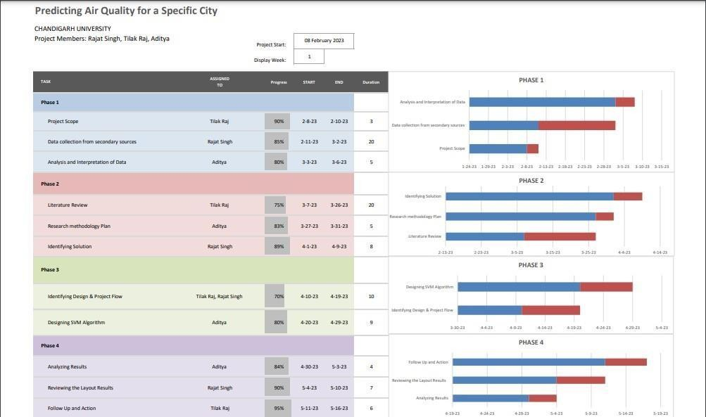
1.4. Timeline
Fig 1.1: Time line of the project (Gantt Chart)
1.5. Organization of the Report
Successful completion of a project requires well-organized planning and resource management. The organization of the project in the predicting Air Quality Index for a specific city Project Report can be divided into the following main steps: It should have and what goals it should achieve. Goals should be SMART (specific, measurable, achievable, realistic and time bound).

Slide 11
Project Plan: This phase creates a comprehensive project plan including timelines, milestones, tasks, and deliverables. Make sure the project plan covers all necessary tasks and stakeholders are identified.
Project Team: Select a project team made up of people with the necessary expertise to carry out the tasks identified in the project plan. Assign roles and responsibilities to each team her member to ensure accountability.
Resource Management: Determine the resources required to complete a project, including hardware, software, and personnel. Make sure the required resources are available and allocated according to the project plan.
Risk Management: Identify potential risks that may arise during a project and develop risk management plans to mitigate them. The plan should address how risks are identified, assessed, and managed.
Communication Plan: Develop a communication plan outlining communication channels, frequency, and stakeholders who will receive project updates. It should also detail how stakeholders can provide feedback and raise concerns.
Testing and Quality Assurance: We conduct rigorous testing to ensure that our online auction system is working as intended. Create a quality assurance plan outlining how testing will be conducted and the criteria used to measure success.
Deployment: After successful testing, deploy the online auction system. Ensure ongoing support and maintenance.
Monitoring and Evaluation: After implementation, monitor the online auction system and evaluate its performance against project objectives. Make necessary adjustments as necessary to ensure that the system achieves its purpose.
In summary, organizing a project report project through a system requires careful planning, resource management, risk management, and a comprehensive quality assurance plan. Effective project communication and monitoring is also critical to successful project completion.

Slide 12
DESIGN FLOW/PROCESS
Evaluation & selection of specification/features:
The literature has employed a variety of models, including statistical, deterministic, physical, and machine learning (ML) models, to prognosticate AQI. Traditional styles grounded on statistics and probability are extremely complex and less effective. It has been demonstrated that ML – grounded AQI vaticination models are more reliable and harmonious. Data collecting is now simple and precise thanks to advance technology and detectors. Only ML algorithms are able of handling successfully the position of in-depth analysis demanded to make accurate and reliable prognostications grounded on similar vast environmental data. We looked at six times’ worth of data on India’s civic air pollution and studied ten times’ worth of AQI data. After the dataset has been pre-processed and gutted, data visualization ways are used to probe retired pattern and trends and ameliorate understanding. Only many scholars in the literature have used the nature of correlation measures with ML models, but our work makes use of it. The SVM model is used to identify and correct data imbalances.
Features of SVM (Support Vector Machine):
Support Vector Machine (SVM) is one of the supervised machine learning algorithms that can be used for either linear regression or type/data modelling. Its one of the machine learning algorithms that’s preferred over colorful algorithms as it helps yield advanced and better rigor. SVM operates on the principle of the Kernel trick and its voguish suitable for double type tasks as the SVM will have minimum classes to operate on near the hyperplane and it also converges hastily.
SVM classifiers perform well in high-dimensional space and have excellent accuracy. SVM
classifiers require less memory because they only use a portion of training data.
SVM performs reasonably well when there is a large gap between classes.
When the number of dimensions exceeds the number of samples, SVM is useful.
Key features taken from above data:
Support vector machines are powerful and important algorithms commonly used to create machine knowledge models on small datasets.
Tuning SVM hyperparameters in Python can effectively improve model performance.
This algorithm works best when the number of boundaries is less than the number of samples and is not recommended for use with noisy, large or complex datasets.

Slide 13
2.2. Design Constraints:
Design constraints are restrictions or limitations in the design process imposed by internal and external factors. These limitations affect the final product, so it is important that everyone in the organization/ team is aware of them and consider these limitations before each project.
Some of the constraints which are imposed in our project are:
Environmental Constraints:
There are various environmental constraints that can be affect the accuracy of air pollution predictions, these include:
Topography: The topography of an area can affects the movement of air pollutants. For example, valleys can trap pollutants, leading to higher concentration, while hills and mountains can disrupt the movement of air.
Urbanization: urbanization can lead to higher level of air pollution due to increased traffic, industry and human activities. Additionally, urban areas tend to have higher concentration of impervious surface.
Safety constraints:
In addition to environmental constraints there are also safety constraints that must be considered when predicting air pollution. These include:
Hazardous materials: some air pollutants can be hazardous or toxic, and may pose a significant risk to human health or the environment.
Emergency response: in the event of an emergency or unexpected event, such as chemical spill or industrial accident, air pollution may be need to be update in real time to ensure that emergency responders have the information they need to take appropriate action.
Heath constraints:
Health constraints are an important consideration when predicting air pollution, as pollution can have significant impact on human health. These include:

Slide 14
Health effect of pollutants: different pollutants can have different health effects, and the severity of these effects can vary depending on factors such as, the length and intensity of exposure, age, and pre-existing health conditions.
Access to healthcare: in some cases, people may not have access to adequate healthcare, which can increase the risk associative with exposure to air pollution. Prediction of air pollution must take into account, the potential impact of limited access to health care and ensure that any recommendations.
Social and political constraints:
Social and political constraints can also play a role in predicting air pollution. These include:
Economic considerations: economic factors, such as the cost of pollution and control technologies or the economic benefits of certain industries, can influence decisions about how to address air pollution.
Political will: the political will to address air pollution can be a significant constraint on the effectiveness of predictions and recommendations.
Economic constraints:
Economic constraints can be an important factor in predicting air pollution, as effort to reduce pollution can have significant economic effect, these include:
Cost benefit analysis: in some cases, the economic benefit of certain industries or activity may be weighed against the cost of pollution reduction efforts. Predictions of air pollution must take into account potential, economic impact of pollution reduction effort.
Funding and resources: pollution reduction efforts may require significant funding and resources, and availability of these resources must be considered while making predictions about the effectiveness of those efforts.

Slide 15
2.3. Analysis of features and finalization subject to constraints:
Constraints can have significant impact on the accuracy and reliability of prediction of air pollution. Here are some ways in which constraints can be modified to improve the accuracy of air pollution prediction:
Modification in environmental constraints:
Here are some ways in which in which environmental constraints can be modified to improve the accuracy of air pollution prediction:
Improved monitoring and data collection: one of the most important ways to improve air pollution prediction is to improve the quality and quantity of data that is available for analysis.
Better modelling techniques: advance in modelling techniques can also improve the accuracy of air pollution prediction. For example, incorporating data from satellites observations, using machine learning algorithms and integrating data from multiple resources.
Addressing the impact of climate change: climate change can have a significant impact on air pollution levels, particularly as extreme weather events become more common. By accounting for the impact of climate change in air pollution models.
Modification in safety constraints:
Here are some ways in which safety constraints can be modified to ensure the safety of individuals while predicting air pollution:
Ensure proper training for personnel: personnel involved in predicting air pollution level should receive proper training to ensure that they are able to operate monitoring equipment safely and to handle any hazardous materials safely.
Implement safety protocols: standard operating procedures and safety protocols should be established to ensure that personnel are following best practice for monitoring air pollution.
Establishing safe monitoring location: monitoring equipment should be located in areas that are safe for personnel and the public. This may involve selecting location that are away from heavily trafficked areas, producing the risk of accident and exposure to pollutants.

Slide 16
Modification in health constraints:
Here are some ways in which health constraints can be modified to ensure the health of individuals while predicting air pollution:
Improve health data collection: to better understand impacts of air pollution on public health, it is important to collect data on health outcomes of individuals who are exposed to high level of pollutants.
Improve access to healthcare: improving access to health care can help to reduce the heath impacts of air pollution. This can involve the developing programs that provides access to medical care of individuals who are at high risk of health impacts form air pollution.
Monitor vulnerable populations: certain populations, such as children and elderly are more vulnerable to the health impact of air pollution. By monitoring these populations closely, public health officials can develop targeted interventions to protect their health.
Design Flow
The design process for predicting air quality for a specific city includes a few steps to make a viable and exact forecast demonstrate. The following are a few imperative steps within the plan process for discuss quality expectation:
Data collection: the first step in planning and discussing quality forecast show is to gather significant data. The information collected can include chronicled air quality information for the city, meteorological information, land information, and other natural components that will influence discuss quality. The information ought to be dependable and up-to- date to guarantee precise expectations.
Data preprocessing: after collecting the information. It must be cleaned and pre-processed to evacuate any mistakes, irregularities, or lost values. This could include data normalization, highlight choice, and other information is of tall quality and appropriate for the show.
Model choice: once the information is pre-processed, an appropriate show must be chosen for the expectation. Different machine learning algorithms/models such as Artificial Neural Network (ANN), Scalar Vector Machine (SVM), etc.
In the context of predicting air quality for a specific city, a design process could be used to guide the development of the software system that performs the prediction. There are two possible design process model that could be used are the ER Model and Use-Case Diagram.

Slide 17
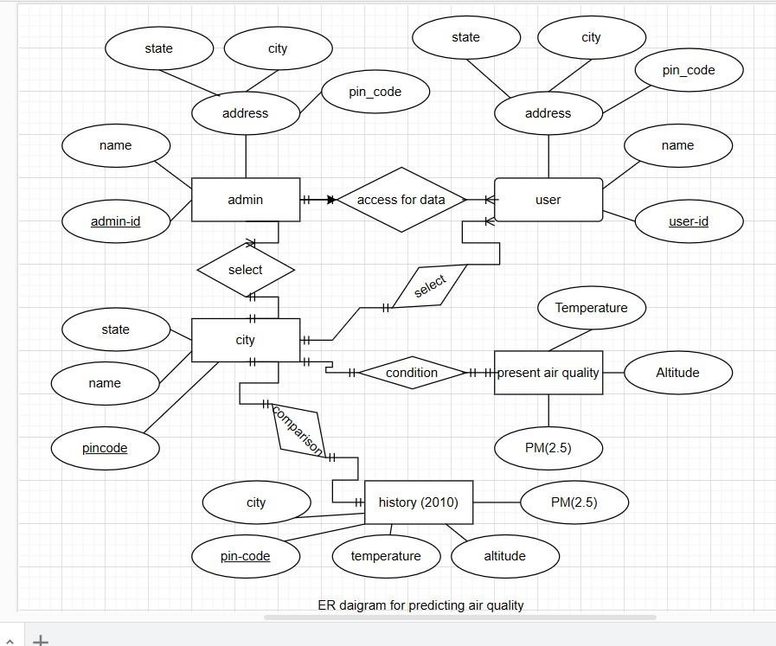
ER DIAGRAM:
Fig 2.1: ER diagram for predicting air quality
The ER diagram for anticipating air quality for a specific city incorporates various entities such as City, Air Quality, Prediction, Admin, User, Present Air Quality, History of the sir quality, etc.
The City entity speaks to a city and incorporates data such as state, name, pin-code, to recognize it.
The air quality entity contains data approximately the air quality in a particular city, altitude, temperature. It incorporates traits such as co2, no2, o3, pm2.5, and pm10, which are measures air quality. It moreover incorporates a timestamp quality, which demonstrates the time when the air quality information was recorded. The air quality entity is connected through the city and history of the air pollution of that city.
The history entity contains data approximately the historical air quality file (predicted aqi) for a particular timestamp and city. The history entity is connected to both city and present air quality entities through their particular city and air qualities.
To summarize, this ER diagram speaks to a fundamental structure for predicting air quality list for a particular city by putting away and partner historical air quality data with cities and timestamps, and utilizing this information to produce forecasts of the air quality file for future times.

Slide 18
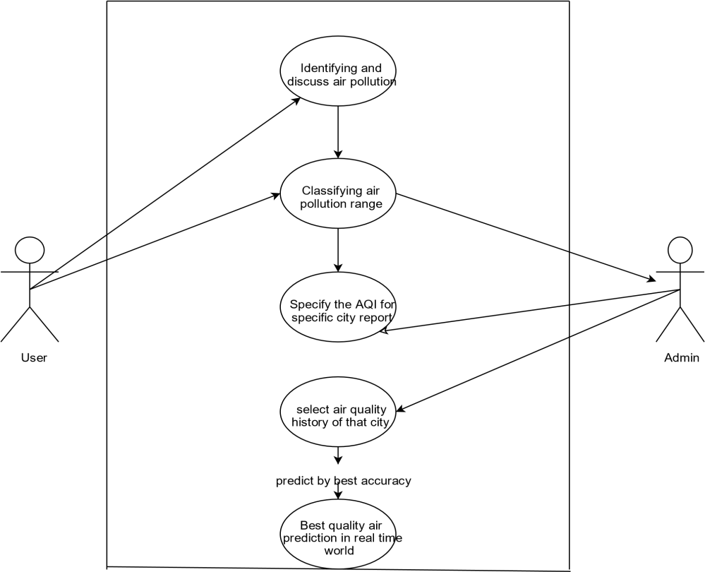
USE-CASE DIAGRAM:
Fig 2.2 Use Case diagram for predicting AQI
The use-case diagram comprises of two fundamental components: actors and use cases.
Actors: the actor in this utilize case chart is the client. The client is the individual or framework that interatomic with the discuss quality expectation framework to ask a expectation for a particular city.
Use-Case: the use case in this diagram is “Predict Air Quality Index”. This speaks to the most usefulness of the framework. Which is to anticipate the discuss quality index for a particular city based on historical information. Meteorological information, geological information, and other natural components.
The flow of the use case is as follows:
The user demands an expectation for the Air Quality for a Specific City.
The framework recovers significant information, counting verifiable air quality information, meteorological information, geological information, and other natural variables for the particular city.
The system processes the information employing a appropriate machine learning model to
anticipate the air quality index for a particular city.
The system presents the predicted air quality record to the user.

Slide 19
This use-case diagram gives a high level view of the air quality prediction system and the interactions between the User and the system/Admin. It may be a supportive device for understanding the functionality of the framework/system and for the recognizing any extra utilize cases or actors that may need to be considered.
2.5. Design selection
After analyzing both the models/diagram for predicting air quality index for a specific city, we have come to the conclusion that the best model to show the behavior and working of the SVM method for predicting the air quality index for the specific city is the
ER Diagram.
Fig 2.3: specific ER diagram for predicting air quality
We have chosen the ER diagram because an Entity-Relationship (ER) diagram is a graphical representation of entities and their relationships to each other. It is commonly utilized in database plan to show information and their relationships. In any case, an ER diagram alone appropriate for anticipating air quality index (AQI).
The forecast of AQI requires information/data related to different variables such as climate conditions, discuss contamination levels, and other natural parameters. Hence, a combination of information sources and modelling strategies would be required for anticipating AQI precisely.

Slide 20
An ER diagram can be utilized as apparatus to get it the connections between different substances included in collecting and analyzing AQI information. For case, an ER graph can offer assistance to recognize the connections between the substances such as climate stations, air quality sensors, and information investigation frameworks.
Moreover, an ER diagram can too, offer assistance in distinguishing the properties of each substance, such as area, sensor sort, and estimation units. This data can be utilized to plan a database pattern for putting away and preparing AQI information.
In any case, the use of an ER diagram alone isn’t adequate for anticipating AQI, as the main work of a model is to convey the user about how the working of air quality prediction will be carried out, it will give an out layer of the model but not the proper regression techniques. For actual and precise prediction and result analysis, there are various methods such as regression analysis and machine learning.
In outline, an ER diagram can be a valuable apparatus for understanding the connections between different substances included in collecting and analyzing AQI information.
On the contrary, we haven’t considered the use-case model because a use-case diagram is a graphical representation of how a system interacts with clients or other frameworks to attain a particular objective. It is commonly used in computer program designing to model the behavior of a framework. In any case, a use-case diagram alone isn’t appropriate for foreseeing air quality prediction.
The forecast of AQI requires data related to different variables such as climate conditions, discuss contamination levels, and other natural parameters. In this manner, a combination of data sources and modelling procedures would be required for forecasting AQI precisely.
A use-case diagram would not be reasonable for anticipating AQI since it basically centres on the interactions between a system and its clients or other entities. It does not give a implies of representing the complex connections between the different natural variables that predict AQI.
In rundown, a use-case diagram would not be appropriate for predicting AQI because it does not
give the fundamental detail or modelling strategies for precisely anticipating AQI.
Implementation plan/methodology
The implementation of the system in the form of flow chart simply shows how the new method should be applied (SVM) in order to ensure good performance which can be achieved via system/method conversion or changing over from the old system to the new system/method.
The components of high-level flowchart for predicting AQI:
Collect data: Collect data quality information from different sources, such as climate
stations, air quality sensors, and other natural parameters.

Slide 21
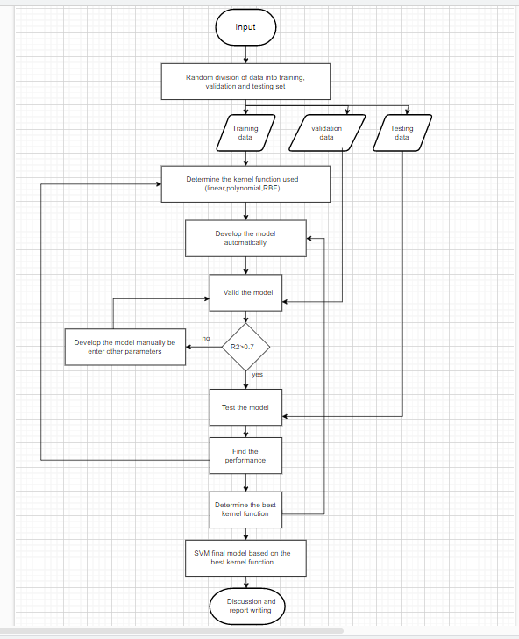
Data cleaning and processing: Clean and pre-process the collected information, such as expelling copies, filling in lost values, and scaling the information.
Feature selection: Select pertinent highlights from the pre-processed information/data, such as temperature, humidity, and air toxin levels.
Data split: split the information into preparing and testing sets.
Training the SVM model: Prepare the SVM show on the preparing information/data utilizing the chosen highlights.
Model Evaluation: Assess the SVM model’s execution on the testing information utilizing assessment measurements such as precision, accuracy and review.
Model deployment: Deploy the prepared SVM show to anticipate AQI in real-time.
Fig 2.4 flowchart for predicting AQI using SVM

Slide 22
RESULT ANALYSIS AND VALIDATION
1. Implementation of solution
Result analysis and validation are imperative components of a venture report that offer assistance to guarantee the precision and unwavering quality of the extended discoveries.
Result analysis includes analysing the information collected amid the extended to distinguish designs, patterns, and connections that can offer assistance to reply the inquire about questions or test the extended speculations. This investigation can include measurable tests, information visualization techniques, or other strategies to assist decipher the information.
Validation, on the other hand, includes checking the exactness and completeness of the information, as well as guaranteeing that the venture discoveries are steady with the inquire about destinations and strategy. This may include checking the information for blunders, confirming the comes about with other sources of data, or testing the extend discoveries utilizing elective strategies or approaches.
Both result analysis and validation are imperative for guaranteeing the meticulousness and legitimacy of a extended report. They offer assistance to guarantee that the extend discoveries are precise, solid, and pertinent to the investigate questions or targets, and they give a strong establishments for drawing conclusions and making suggestions based on the project comes about.
2. Project management and data validation for the project:
By and large, report arrangement/preparation is fundamental in guaranteeing that a venture is effective. It makes a difference to guarantee clear communication, responsibility, documentation and assessment.
The most important aspects of the report preparation is how the responsibilities of the individuals are divided in the project. We have also divided our responsibilities by far in most effective manner so that the output of the report as well as the project are both well communicated to the audience.
The first and the foremost task is to make the wireframe and prototype of how the website will look (UI/UX). UI designing is the most critical step in making any website also The making of the prototype and UI is handled by Rajat Singh. We have made sure that while prototyping the UI of the website, we should keep the users need in mind, whether we want a website to be clutter free or full of unnecessary plugins.

Slide 23
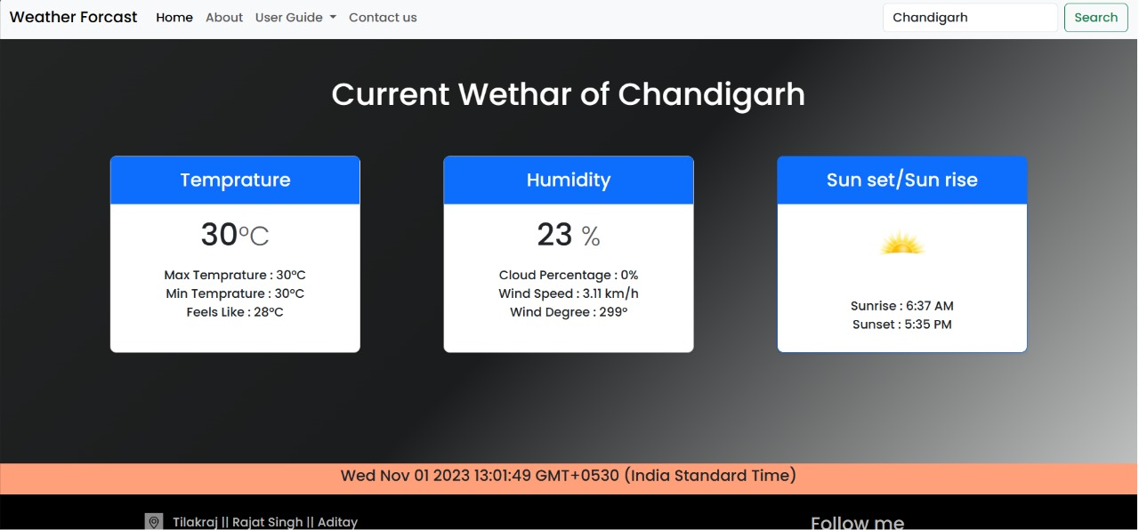
The second important thing is to design various models and coding implementation for making weather monitoring website. In the context of predicting air quality index for a specific city, a design process could be used to guide the development of the software system that performs the prediction. There are two possible design process models that could be used are the ER Model and the Use- Case model, which are already stated above. The model designing and implementation are all handled by our sincere member Tilak Raj.
The third but the one of the crucial states is identifying constraints and defining future scope and solving them. Identifying constraints is an important step in predicting air quality index (AQI) since it makes a difference to guarantee that the model precisely reflects the real-world conditions and confinements that will influence the precision of the forecasts. The identifying and solving of constraints are handled by Aditay.
The fourth and the last phase is the implementation of the project while keeping in mind all the aspects of the topic, weather it be data collecting, data processing, designing of the model for the project and the constraints or the limitations which comes in between the projects. After resolving all the conflicts, cleaning the data and processing comes the process of implementation which are handled by Rajat Singh and Tilak Raj.
Fig 3.1 web application home page

Slide 24
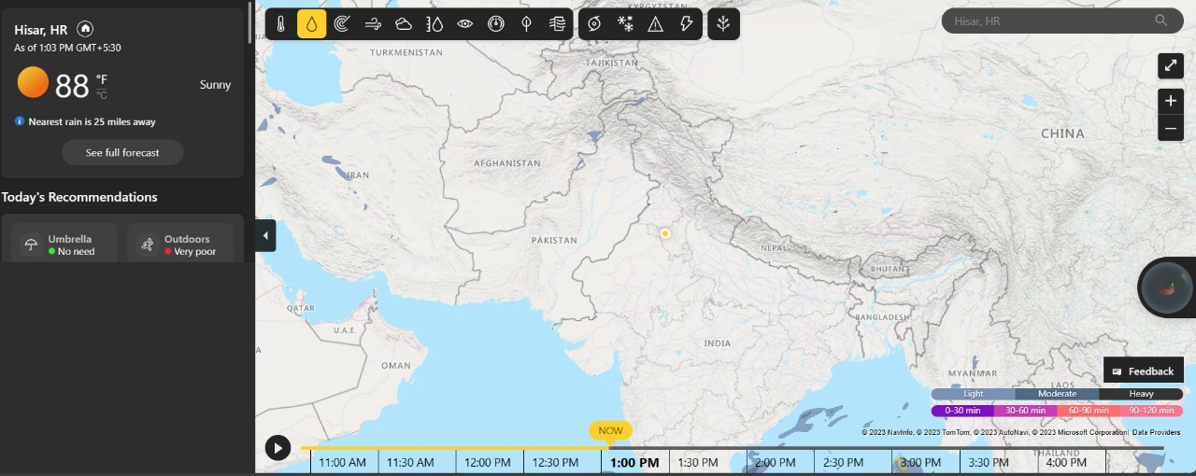
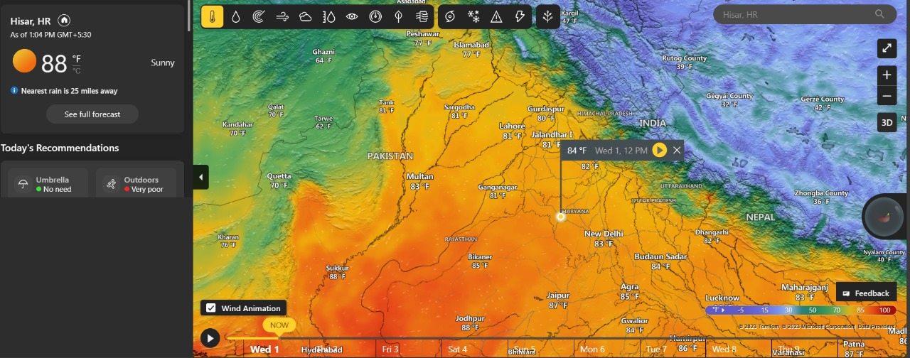
Fig 3.2 web application (precipitation chart)
Fig 3.2 web application (Heat Map)

Slide 25
CONCLUSION AND FUTURE WORK
1. Conclusion
In conclusion, the Support Vector Machine (SVM) calculation has been appeared to be a compelling device for foreseeing the Air Quality Index (AQI) for a particular city. By consolidating different meteorological parameters, the SVM model can capture the complex connections between distinctive variables that influence the air quality of a locale.
The execution assessment of the SVM model utilizing factual measurements such as Root Mean Square Error (RMSE), Mean Absolute Error (MAE), and coefficient of determination (R^2) shows that the model can precisely foresee the AQI of the target city. The tall precision of the show can give important bits of knowledge for policymakers and natural offices to require fundamental activities to move forward the air quality of a locale.
This ponder illustrates the potential of machine learning calculations in foreseeing AQI and can be learning calculations in foreseeing AQI and can be amplified to other cities for natural observing and administration. The SVM demonstrate can be assist refines and optimised by joining more information and creating progressed calculations. Generally, this ponder highlights the significance of utilizing machine learning calculations for natural observing and administration and can contribute to making a feasible and sound environment for future eras.
2. Future Work
In this study, the information utilized was static which means the information will be settled and it remains the same after it’s collected. In any case the government overhauls the data hourly. Advance we will utilize real-time information/data investigation utilizing cloud to get way better results for greater performance as the information upgrades for each specific interim of time. Able to encourage outfit two or more machine leaning calculations and handle expansive information to induce more exact comes about.

Slide 26
REFERENCES
https://www.diva- portal.org/smash/get/diva2:1681590/FULLTEXT02#:~:text=Air%20quality%20index%20 (AQI)%20is,used%20to%20forecast%20the%20AQI.
https://www.kaggle.com/code/kewalchavan/air-quality-index-prediction-using-svm
https://rpubs.com/Learning-Monk/air-quality-in-indian-cities
https://link.springer.com/article/10.1007/s13762-022-04241-5
https://www.sciencedirect.com/science/article/abs/pii/S2213343719303318?fr=RR- 2&ref=pdf_download&rr=7c37475d0ca48e78
https://www.researchgate.net/publication/333686129_Prediction_of_air_pollution_index_ API_using_support_vector_machine_SVM
https://ieeexplore.ieee.org/document/1005545
https://link.springer.com/article/10.1007/s13762-022-04241-5
https://arxiv.org/ftp/arxiv/papers/2112/2112.05753.pdf
https://www.ijraset.com/research-paper/prediction-of-air-quality-index-using-supervised- machine-learning
https://ijariie.com/AdminUploadPdf/A_Survey_on_Machine_Learning_Based_Prediction_ of_Air Quality_Index_ijariie15775.pdf

Slide 27

APPENDIX
Plagiarism Report:
PLAGIARISM SCAN REPORT
 |  | Date | 2023-10-31
7% Plagiarised | 93% Unique
 |  | Characters | 4890
Words
8984
Matched Source
Similarity 8%
Title:Project 2 - Supply and Demand Gap Analysis : Skill-Lync
Web · Q.1:- PROS OF SVM: SVM classifiers perform well in high-dimensional space and have excellent accuracy. SVM classifiers require less memory because they only use a portion of the training data. SVM performs reasonably well when there is a large gap between classes. High-dimensional spaces are better suited for SVM. When…
Check
Similarity 8%
Title:Pros and cons of Support Vector Machine (SVM) - RoboticsBiz https://roboticsbiz.com/pros-and-cons-of-support-
vector-machine-svm/
Similarity 8%
Title:Supervised Learning - Classification Week 7 Challenge
Nov 6, 2022 — When the number of dimensions exceeds the number of samples, SVM is useful. SVM uses memory
effectively. CONS OF SVM:.
https://skill-lync.com/student-projects/supervised-learning-classification-week-7-challenge-75

Slide 28
USER MANUAL
Design checklist:
Planning a checklist can offer assistance guarantee that the prescient demonstrate for air quality index (AQI) utilizing support vector machine (SVM) is created in a precise and comprehensive way. Here are a few key things to incorporate within the checklist:
Information collection: assemble chronicled data an AQI and meteorological parameters for the target city. Ensure that the information is exact, dependable, and covers a adequately long period capture regular activities.
Information pre-processing: clean the information to evacuate exceptions, lost values, and irregularities. Perform feature selection to distinguish the forecast significant meteorological parameters that influence AQI.
Data splitting: separate the information into preparing, approval, and test sets. Ensure that the data is arbitrarily inspected and stratified to dodge overfitting.
SVM model selection: select a suitable SVM demonstrate with the fitting part work and hyperparameters. Assess the execution of the SVM show utilizing cross-validation procedures and factual measurements such as RMSE, MAE, R^2.
Model tuning: fine-tune the SVM model hyperparameters to optimize the execution on the approval set. Test with different hyperparameters and part capacities to recognize the most excellent combination.
Model assessment: assess the ultimate demonstrate execution on the test set. Ensure that the model generalise well to concealed data and gives precise forecasts of AQI.
Result interpretation: decipher the SVM model comes about to pick up experiences into the components that influence AQI. Create visualizations and reports communicate the discoveries to partners.
Future work: recognise zones for future work, such as incorporating more meteorological parameters, investigating distinctive part capacities, or creating an outfit of models.
Documentation: document the whole prepares, counting information collection, pre-processing, demonstrate determination, tuning, assessment, and translation. Ensure that the documentation is evident, brief and reproducible.
By following this checklist, analysts can create a vigorous and precise prescient show for AQI utilizing SVM and contribute to moving forward natural checking and administration.

